Slide 1
Time Series Searching, Forecasting, and Classification with Applications in Bioinformatics 時系列の探索・予測・分類とその生命情報学 への応用
Coleman Yu
余 浩旻
cyu@kuicr.kyoto-u.ac.jp
Pre-defense (20-01-2026)
Graduated from HKUST.
I am from Hong Kong.
This slide can be found at https://github.com/colemanyu/coleman-kyoto-u-phd-thesis.
Notes:
Greeting.

Slide 2
Outline
Introduction
1. MTSCCleav: a Multivariate Time Series Classification (MTSC)-based Method for Predicting Human Dicer Cleavage
2. Scaling with Multiple Scaling Factors in Time Series Searching
3. Leveraging Nearest Neighbors for Time Series Forecasting with Matrix Profile
Conclusion
Bioinformatics
Distance Measure
A data mining primitive
Notes:
The first study is about Bioinformatics.
The second one is about to develop a more generalized distance measure.
The third one is using a data mining primitive to improve the forecaster.

Slide 3
Outline
Introduction
1. MTSCCleav: a Multivariate Time Series Classification (MTSC)-based Method for Predicting Human Dicer Cleavage
2. Scaling with Multiple Scaling Factors in Time Series Searching
3. Leveraging Nearest Neighbors for Time Series Forecasting with Matrix Profile
Conclusion

Slide 4
Introduction
Subsequence?
What is Time Series?
Time Series is everywhere!
Tasks on Time Series
Transformation!
Similarity (Distance) is important!

Slide 5
What is Time Series?
A measurement
Behavioral attribute
A Real Number
A Time Series T = t₁, t₂, …, t_{n} with length = n
Uniform sampling rate
A timestamp
Contextual attribute
A discrete index
T = 1, 0, -1, 1.1 ✅
T = A, G, C, T ❌
T = 1, 2, 3, 4 ✅
String
Alphabet
Notes:
Time series
[keogh2022finding]

Slide 6
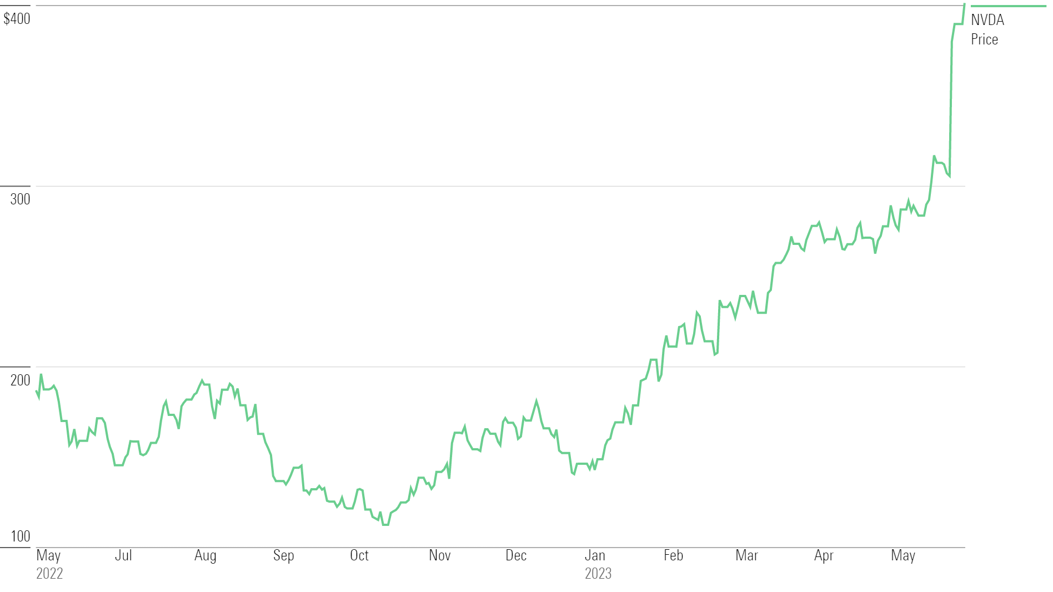
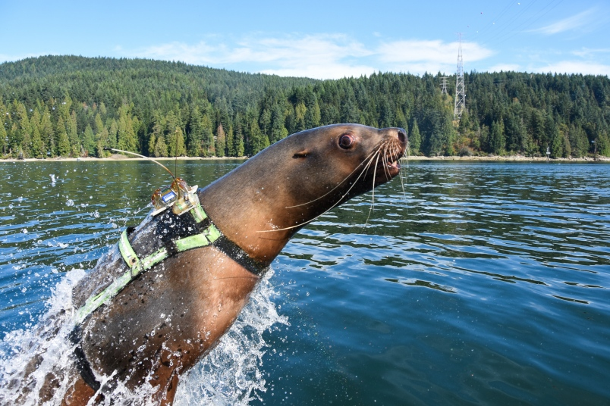
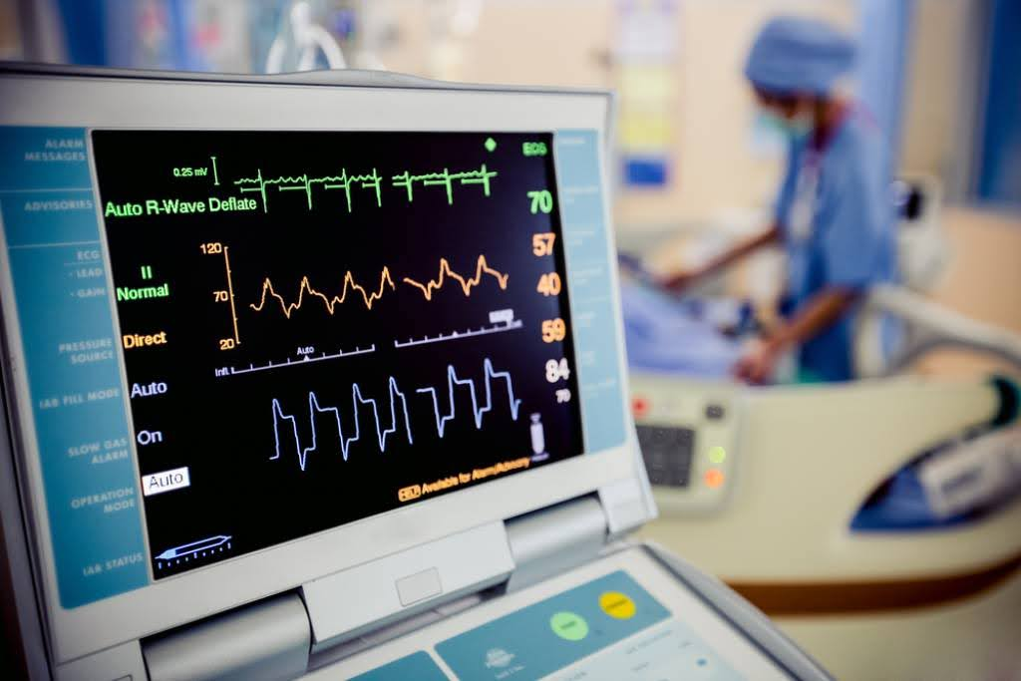
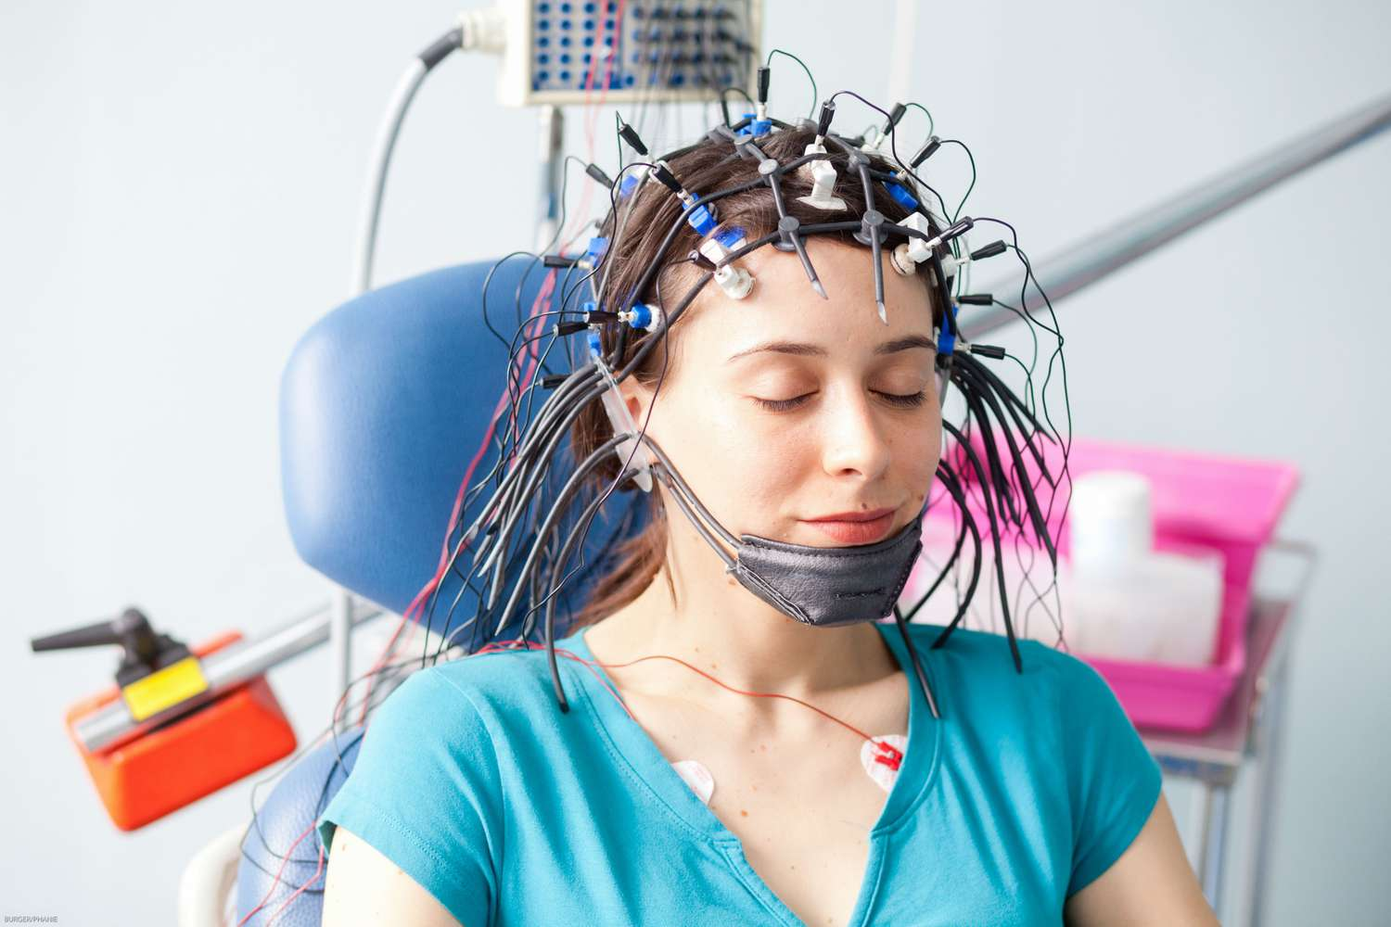
Everywhere!
1. Stock price
2. Motion data
3. ECG, EEG
Notes:
NVIDIA stock price
https://cloudfront-us-east-1.images.arcpublishing.com/morningstar/MH3VK6KGVBGWLCTU6PCQPHZL5Q.png
Motion data time series
[keogh2022finding]
ECG, EEG
https://avicennacardiology.com/blog/what-is-an-ecg-machine-complete-guide/
https://www.verywellhealth.com/thmb/cGLVsyR-_yBenHLf1IEddKky2f8=/1500x0/filters:no_upscale():max_bytes(150000):strip_icc()/eeg-601235088-5a524fdef1300a0037eeebe5.jpg

Slide 7
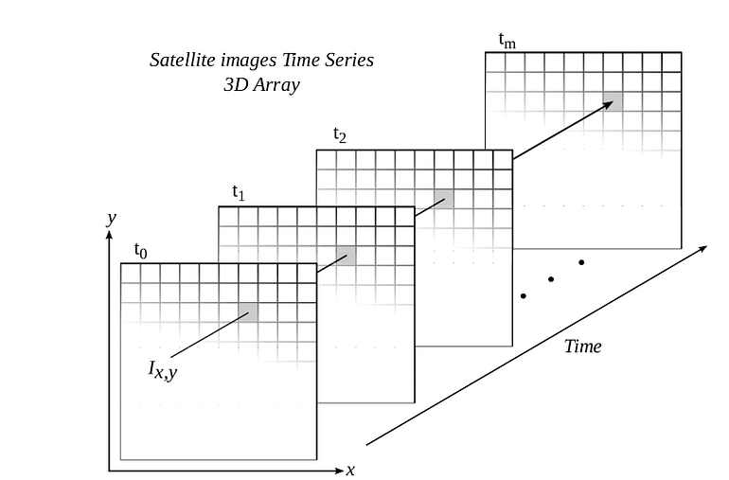
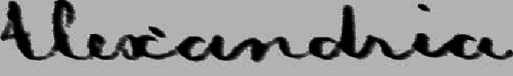
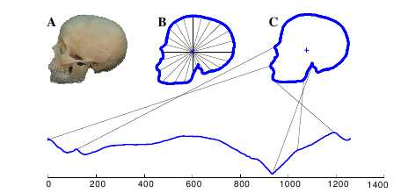
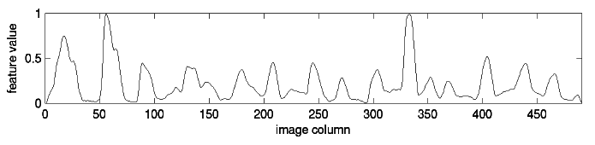
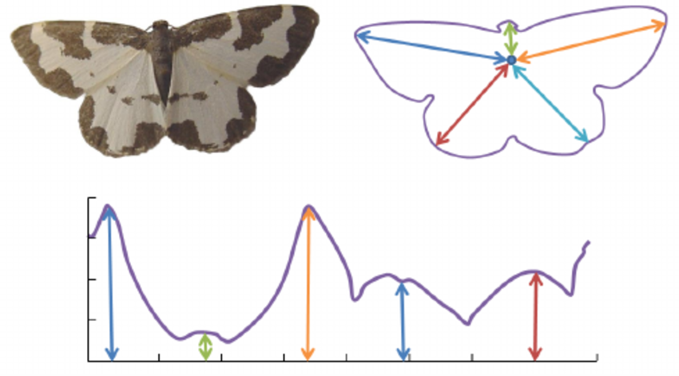

And More! Transformation!
4. Satellite Image Time Series (SITS)
From green to brown
Deforestation
contour
2. Linear scanning
1. Angle-based method
center
Same location
3. Image to Time series
An image
1D array of pixels
1D array of pixels
Flattening
.
.
.
Notes:
Skull, handwriting
https://www.sktime.net/en/v0.20.0/examples/02_classification.html
https://izbicki.me/blog/converting-images-into-time-series-for-data-mining.html
Butterfly
https://www.researchgate.net/figure/llustration-of-conversion-of-shapes-into-time-series-starting-with-an-image-of-a-moth_fig3_221226668
Satellite Image Time Series (SITS)
https://medium.com/@vishal.d_62653/time-weighted-dynamic-time-warping-in-satellite-image-time-series-3b19936aa857

Slide 8
Subsequences
Sliding window with length = m
The last one
The first one
m-subsequence
1 2 3 4 5 6
1 2 3
2 3 4
# subsequences = n-m+1
3 4 5
# subsequences = 6-3+1 = 4
4 5 6

Slide 9
Tasks
A Time series T with length n
A Time series
View it as a point in n-dimensional space

Slide 10
Clustering
Task
No colors = No labels

Slide 11
Classification by a model
We train on the data to obtain a model parameterized by some parameters.
Task
Left => Red
Right => blue
Colors: Labels
This line is a model
Red pts: Negatives
A complex model will have a curly line
Blue pts: Positives
On the left
=> It should be blue.

Slide 12
Classification by Nearest Neighbor (NN)
No higher level has been learnt.
This method is ”lazy”.
A famous classifier in the field of time series
Task
Colors: Labels
If k-NN, majority vote.
It should be blue.
Uses NN’s label as its label
Find its nearest neighbor

Slide 13
Querying
Task
Also called searching
It is the desired output.
But how to define it?
Find its nearest neighbor

Slide 14
Forecasting
Train/Test split
Task
Now!
Know this
Want to know this
Notes:
https://www.emft.fraunhofer.de/en/research-development/system-solution-ai/ai-algorithms-time-series-analysis/jcr:content/contentPar/sectioncomponent/sectionParsys/imagerow/imageComponent3/image.img.jpg/1705393267287/forecasting-engl-mls-emft.jpg

Slide 15
Similarity
Invariance
What aspect to focus/ignore
Should match our intuition
How to define it?
Distance measure (Similarity)

Slide 16
Invariance in Images
In different applications, different invariance
Mirror
Rotation
Input
Size
Not quite?
Sometimes you can see people use a mirror-image transformation on YouTube videos to bypass the copyright detector.

Slide 17
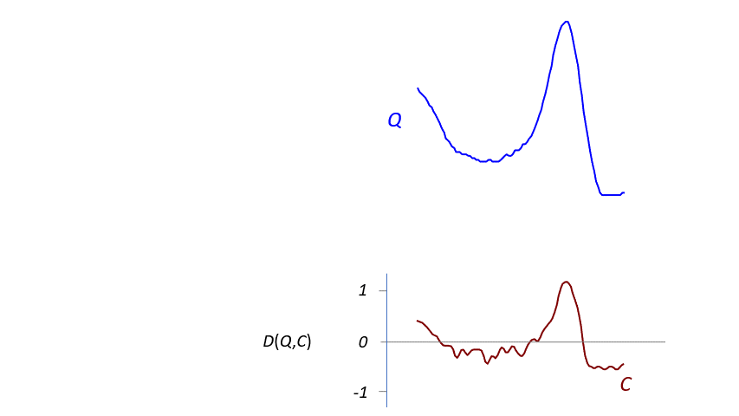
Euclidean distance & Z-normalization
The most common similarity measure in Time Series
(T −mean(T))/ std(T)
just offset
1st point to 1st point
Lock-step
Notes:
Animation
[keogh2025time]

Slide 18
Multivariate time series
Sensor 1
Otherwise, padding
Sensor 2
Need to have the same length
…
…
Sensor C
A Channel
Each entry is a vector of length C
Or you can think there are C parallel time series
Notes:
Red time series
[p12, keogh2025time]
Green time series
[p39, keogh2022finding]
Blue time series
[p30, keogh2022finding]

Slide 19
Outline
We also have some evaluation metrics to determine ”goodness”.
It means we have data and machine learning models
It is a bioinformatics study, tackled by a machine learning way.
Introduction
1. MTSCCleav: a Multivariate Time Series Classification (MTSC)-based Method for Predicting Human Dicer Cleavage
2. Scaling with Multiple Scaling Factors in Time Series Searching
3. Leveraging Nearest Neighbors for Time Series Forecasting with Matrix Profile
Conclusion
Task

Slide 20
Bioinformatics
The location is a covariate
Why is it important?
Biology
Biotechnology
Informatics
Prepare/Curate the dataset
Augment the dataset (Secondary Structure)
Transformation into a Multivariate time series
Convolution-Based Classifiers
ROCKETS and its variants
For example, if a teenager lives near the campus, he is more likely to be a college student.
What kind of data can we observe?
Define input/output relationship
Covariates
9 encoding methods
Find useful information
5 classifiers
Then feed into a simple classifier. A ridge classifier is used.
Use convolution to extract some information
This information is deemed to capture some high-level concept
Notes:
Story of gene expression time series data

Slide 21
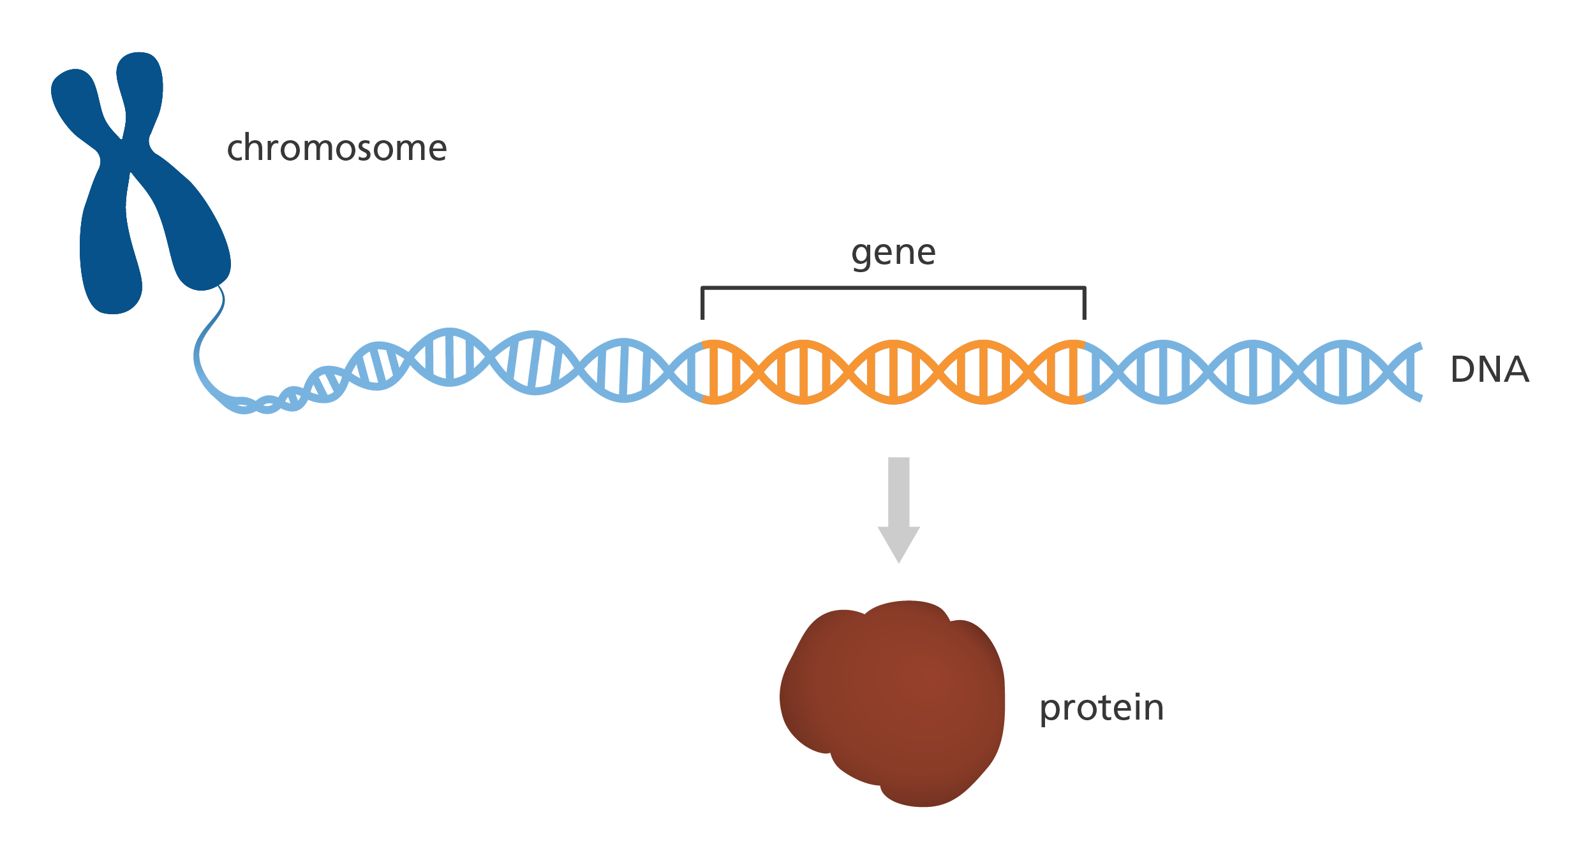
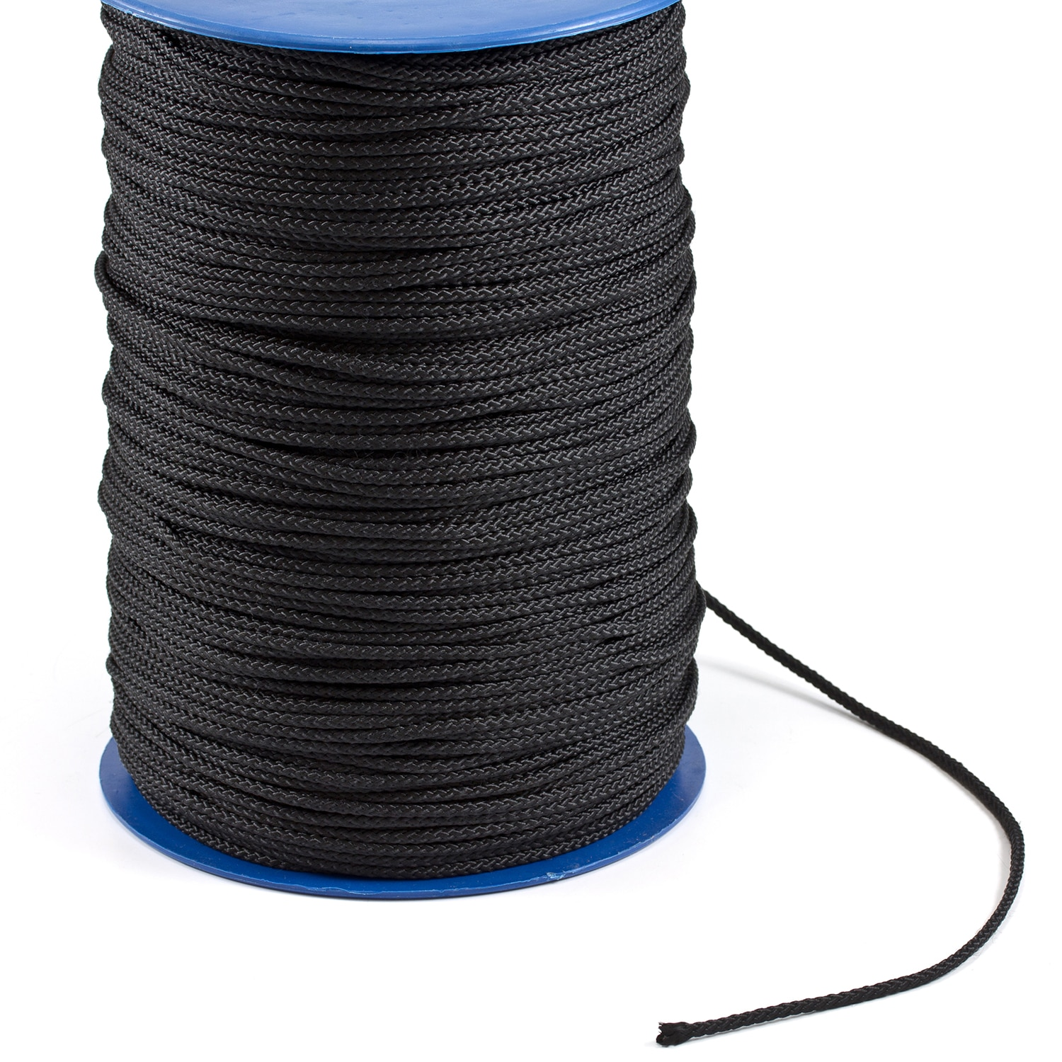
Biology (1/3)
A bundle of rope
Chromosome
DNA
Rope
Protein
Central dogma = Flow of genetic information
General
transcription
translation
DNA
RNA
Protein
Source code
Assembly code
Executable file
In detail
Coding RNA
DNA
mRNA (messenger RNA)
Protein
ncRNA
Non coding RNA
Notes:
https://www.yourgenome.org/theme/what-is-a-gene/
https://content-eu-4.content-cms.com//a1fd41ce-6a62-46be-bba4-1c93e351ebf4/dxresources/1927/1927137f-41b1-4866-9feb-c2a97a59d750.jpg?resize=1500px%3A1500px&crop=1500%3A1500%3B0%2C0

Slide 22
Biology (2/3)
The 2006 Nobel Prize in Physiology or Medicine
ncRNA
siRNA (small interfering RNA)
miRNA (microRNA)
miRNA
primary miRNA (pri-miRNA) → precursor miRNA (pre-miRNA)
pre-miRNA → miRNA
Important discovery
RNA interference (RNAi)
Shut down a gene by degrading the corresponding mRNA
The generation (biosynthesis)of miRNA is important
Phase 1
cuts
Dorsa & DCGR8 cleaves pri-miRNA and forms pre-miRNA
Phase 2
An enzyme called Dicer cleaves pri-miRNA and forms miRNA

Slide 23
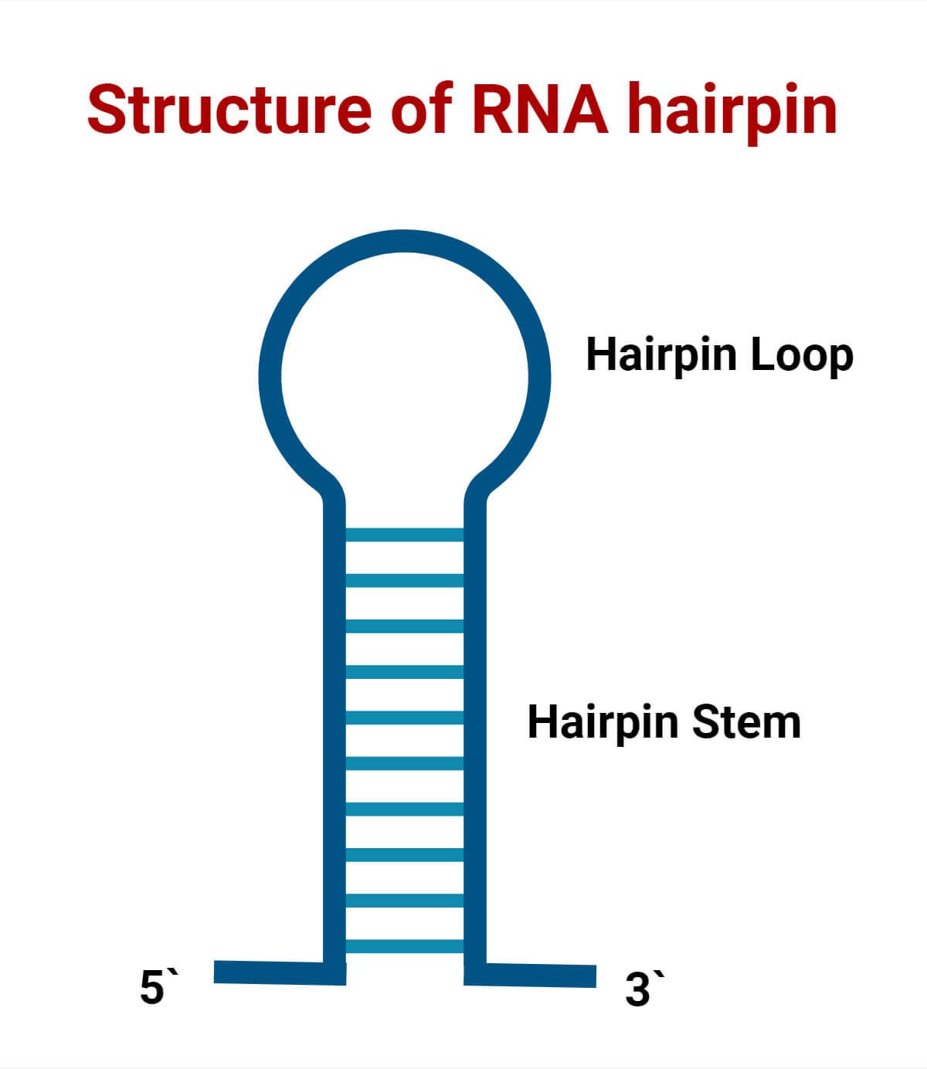
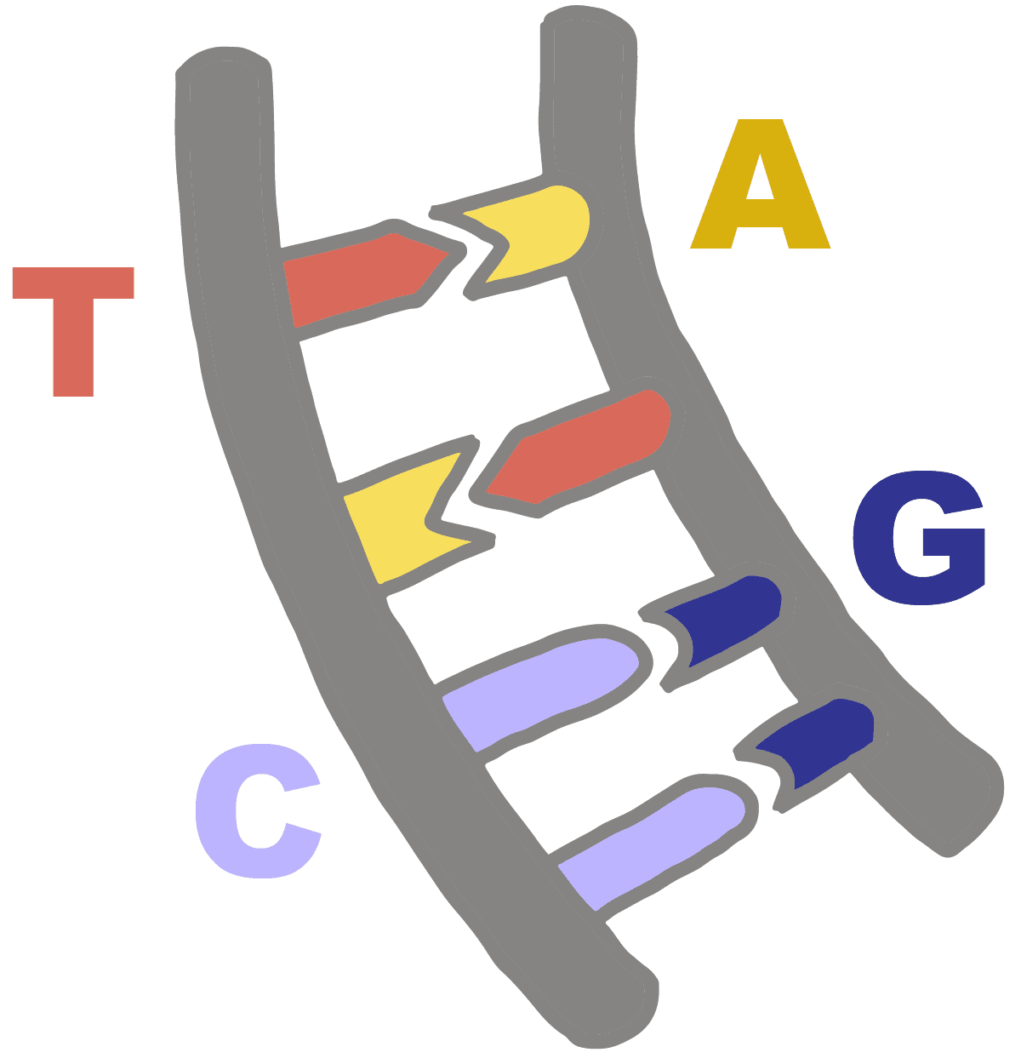
Biology (3/3)
A pri-miRNA contains a hairpin loop
Phase 1: The loop is still preserved
Phase 2 (Dicer): The loop is gone
Dicer cleaves the stem-loop from the two arms at the two cleavage sites.
A nucleotide
Should follow the complementary
A bond between nucleotides
A - U
C - G
3’ arm
Complementary
Notes:
https://microbenotes.com/wp-content/uploads/2024/05/RNA-Hairpin-Structure.jpeg
https://innovativegenomics.org/wp-content/uploads/2024/06/Complementary-1.png

Slide 24
Biotechnology
How we see/measure the data
miRbase database
But wait. Why is it 1D? Biological molecules should be 3D!
Because the methods of “seeing” 3D are expensive
E.g. X-ray crystallography or nuclear magnetic resonance (NMR)
positions

Slide 25
Biotechnology → Informatics
We use some tools to recover the partial structure
Secondary Structure
A guess/prediction from the 1D sequence
Map to 80th
With some probability
No mapping
Map to 1st
No mapping

Slide 26
Visualization
5p non-cleavage pattern
Color intensity: Probability
pri-miRNA
Directionality
A pattern that is 6 nt (nucleotide) away
15
Length = 14
Cleavage site
Similarly, 3p (non-) cleavage pattern
5p cleavage pattern
21
4 patterns
= 4 strings
A pattern that having cleavage site at the center
34
28
Length = 14

Slide 27
What do we have now?
Convert to time series
1
2
But what we also have:
‘‘(’’ maps to 1, ‘‘.’’ maps to 0, and ‘‘)’’ maps to -1
3
Secondary Structure between the two strands (in dot-bracket notation)
4
Probability sequence of each strand
Already time series

Slide 28
Overall pipeline
Two Binary dataset and one multi-class dataset
3p -
OriginalDataset
Interested instances
3p +
5p -
Augment the data
827 5p + dataset
Contribution: New information
Contribution: Frame the problem as a multivariate time series classification problem and propose different encoding methods
Contribution: Much faster than the SOTA
Contribution: We conduct some perturbation-based experiments and find some biological knowledge

Slide 29
Transformation (1/4)
Confidence/ weight
Probability sequence
Single value mapping
Grouped variable-length channel mapping
Encode a string into a time series
Because of the domain knowledge
Encode a string into two time series with different lengths

Slide 30
Transformation (2/4)
Encode a string into two time series with the same lengths
Grouped fixed-length channel mapping

Slide 31
Transformation (3/4)
Or we can use the cumulative approach instead of the absolute approach
Cumulative mapping
Cumulative grouped variable-length channel mapping
Cumulative grouped fixed-length channel mapping

Slide 32
Cumulative
In the cumulative method, we can choose where to start the cumulation
From the start of the pattern
Or from the start of the origin

Slide 33
Summary of 9 Encoding methods

Slide 34
How many channels of time series do we have now
Three types of data (the input features for each instance)
RNA sequence
Primary strand
Complementary strand
Secondary structure information
Base pair probability sequence
“(" maps to 1
“.” maps to 0
“)” maps to -1
A time series

Slide 35
Performance across the channel
Secondary structure is a good covariate
Standalone is better.
Primary strand: 1 or 2 channels
Secondary structure: 1 channel
Complementary strand: 1 or 2 channels
Probability sequence: 1 channel

Slide 36
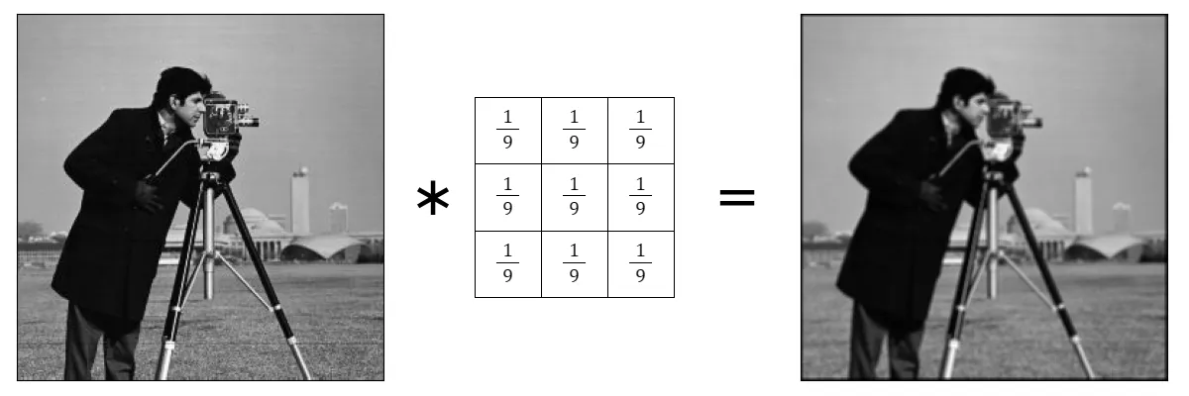
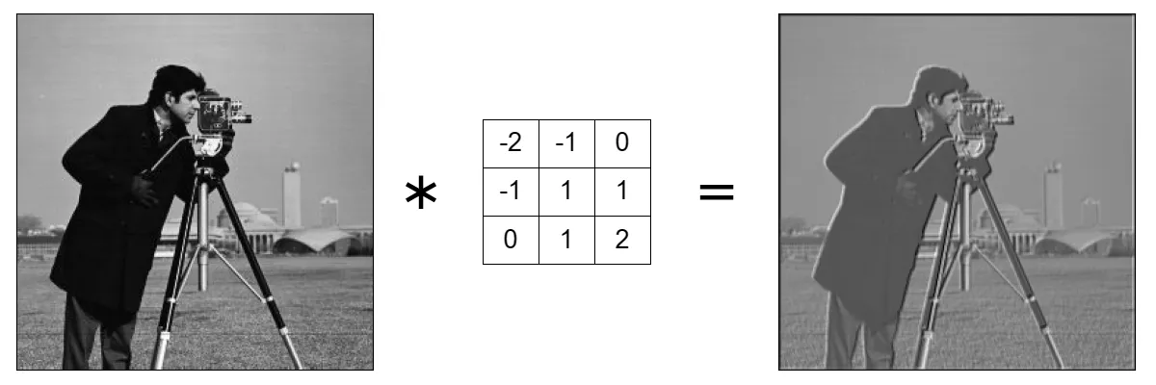
Classifier
A kernel
A time series
Activation Map
A time series
Sliding window
Convolution-Based Classifiers
It uses Convolution to create a time series M of a given time series T
Use M's statistics as features.
Then feed those statistics into other classifier such as Ridge classifier
Randomly select k channels, and find their statistics overall
Features
Statistics
Notes:
https://wiki.cloudfactory.com/docs/mp-wiki/key-principles-of-computer-vision/advanced-convolution-techniques-and-layers

Slide 37
Comparison of rocket-based classifiers
N(0, 1): a standard normal distribution
U(0, 1): a uniform distribution
MultiROCKET-Hydra

Slide 38
Hydra
Features

Slide 39
Ridge regression
The features are then going into
Used as a classifier
The sum of the residual
L₂ norm of the weight vector
When the slope is small, y-value is less sensitive to changes in x-value
L₂ penalty: Used to introduce bias in the fit to avoid overfitting

Slide 40
Evaluation Metric

Slide 41
Results
Think of it as different datasets
CD diagrams
ROCKET is generally the best
MiniROCKET is the fastest

Slide 42
Comparison with SOTA
Here, we report the best combination
Here, we report the best combination with respect to MiniROCKET
In general, enc 7/9 is the best encoding method and ROCKET is the best classifier

Slide 43
Perturbation experiment
Single value
Channel 1
Length = 14
Channel 2
…
Mask of length =4
Important
Significant drop

Slide 44
Outline
Introduction
1. MTSCCleav: a Multivariate Time Series Classification (MTSC)-based Method for Predicting Human Dicer Cleavage
2. Scaling with Multiple Scaling Factors in Time Series Searching
3. Leveraging Nearest Neighbors for Time Series Forecasting with Matrix Profile
Conclusion

Slide 45
How to compare Q and C
Query
Candidate
They are in different scale
They are in different scale
We can just scale up Q to the length of C
Q is similar to a prefix of C
Before applying the distance measure, we need to eliminate the scaling effect.
Limitation: Only one scaling factor

Slide 46
More than one scaling factor
Can it be solved by DTW?
But wait! What is DTW?
A famous elastic distance measure

Slide 47
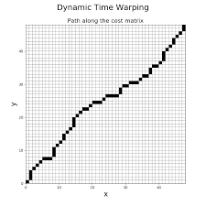
Dynamic Time Warping (DTW)
We can speed this up by constraining the warping path. Band Constraint
O(n²)
The cost matrix has a size of n².
DTW is computed by filling the entries in a cost matrix
elastic
1 to many
r
Optimal Warping path W*
3 pts map to 1 pt
Band
5 pts map to 1 pt
Boundary conditions
Allowed region
Continuity
Monotonicity

Slide 48
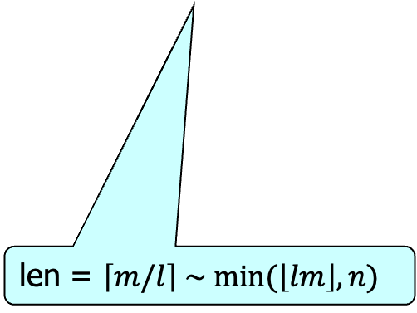
Nearest Neighbor Interpolation and Uniform Scaling
A 4-prefix of T
T =1, 2, …, 6
…
Interpolate to 8
Nearest neighbor interpolation to find the best prefix
Find the best prefix
len = $\left\lceil m/l\right\rceil \sim min⁡(\left\lfloor lm\right\rfloor , n)$

Slide 49
Lower bound
A number that is fast to compute and lower bound from below to the target function
LB_{Kim}
LB_{Shen}
∵ boundary condition
∵ A pt in Q must map to a pt in C
LB_{Keogh}
Form an envelope
We can grow the LB incrementally

Slide 50
Visualization

Slide 51
Use DTW as the core in US => USDTW
US
USDTW
prefix
DTW parameter

Slide 52
How to deal with more than one scaling factor? Our framework PS
Only focus on the prefix
A summation of distances between different pairs

Slide 53
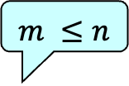
Its DP
j’+1
j
$$m ≤n$$
Problem
The first i point
# pieces
DP
i
i’+1
Similar to O(n²) for DTW, it needs to fill the table of size p*n*m
The min operator takes O(mn)
O(n) for ED or O(n²) for DTW

Slide 54
Speed it up
Similar to bend
We set up the allowed length
Allowed length for a segment in Q
Allowed length for a segment in C

Slide 55
Early Abandoning, Parallel Computing
In nearest neighbor search, we only need to find the nearest search, suppose the current distance between Q and the NN is bsf.
For D[i, j, p], once the result of the subquestion is larger than bsf, we don’t need to consider it anymore
Depends on the state of p-1
So we can run in parallel

Slide 56
Speed up DTW
It is the same in the case of USDTW
It will compare it with a growing subsequence in C
Possible reach
Fixed
For a given L^{Q}-subsequence in Q
For a new subsequence of length L^{Q}+1, we can reuse the previous possible reach to compute a new set of possible reach

Slide 57
Guided Distance
Once we computed PSED or PSDTW, we also have the cut (i.e., how the pairs should be aligned). Based on this cut, we can apply other distance measures within the pairs
Up scale interpolation
Returned by PSD

Slide 58
Querying
5s
GunPoint datast
Two classes: Gun VS Point
Identical
Repeat it three times
Allow variation
Given the blue one, can we retrieve the red one

Slide 59
Results
Our method can achieve this kind of invariance
It means worsen the result
It helps most of them

Slide 60
All ten datasets

Slide 61
Results
The lower bounding can speed up PSDTW but not PSED
Because the overhead of calculating the lower bound outweigh the time saved by pruning
Th following show the effect of using parallel and early abandoning

Slide 62
Leveraging Nearest Neighbors for Time Series Forecasting with Matrix Profile
Introduction
1. MTSCCleav: a Multivariate Time Series Classification (MTSC)-based Method for Predicting Human Dicer Cleavage
2. Scaling with Multiple Scaling Factors in Time Series Searching
3. Leveraging Nearest Neighbors for Time Series Forecasting with Matrix Profile
Conclusion

Slide 63
What is Matrix Profile
It tells us the nearest neighbor information of each subsequence in T_{A} with respect to T_{B}
The similarity
The location
Naïve takes O(n³)
In fact, it can be computed in O(n²)
Matrix Profile (MP)
Matrix Profile Index (MPI)
T_{A}
Besides, the computation can be parallelized
For |T| = 2X, XXX and m = 24, it takes about 1 to 2 seconds on my notebook
T_{B}
m
Matrix Profile (MP) of T_{A} w.r.t. T_{B}
Notes:
[p55, part 1, mueen2017time]

Slide 64
Finding nearest neighbor within itself
Suppose now we only have one time series
Matrix Profile (Index) tells us
For each subsequence with a user-given length m
What is the similarity in ED between it and its NN
Where is its NN

Slide 65
Time Series Forcasting
Given a long time series T, and an integer indicate the split of the training subsequence and test subsequence
|T| = |T_{train}| + |T_{test}|
We would like to train on T_{train} to predict on T_{test}
For example, n = |T| = 26,136
|T_{train}| = 25,968 and |T_{test}| = 168
But we don’t predict the 168 time points in a single shot.
We are only predicting h at one time
Then, we will be given correct answer
Teacher forcing

Slide 66
Gradient Boosting Tree
We only consider the look-backup window of length =w
day of the week or month, holiday or not
Only keep the covariates of the last point of the window

Slide 67
Create more covariates from left nearest neighbor
Similarity
The points after NN
Left nearest neighbor
The points of NN
Same as the setting, only use the last one
Covariates of points of NN
For this subsequence

Slide 68
Datasets
Without covariates
With covariates
We use h points after NN
It is better to use the raw value than the trend or normalized value
It first decreases with more points used

Slide 69
Q & A
Thank you!

Slide 70
References Other references/credits can be found in “Notes” of each slide
[keogh2022finding]
E. Keogh, “Finding Approximately Repeated Patterns in Time Series,” 2022. [Online]. Available: https://u-paris.fr/diip/eamonn-keogh-finding-approximately-repeated-patterns-in-time-series-the-most-useful-and-yet-most-underutilized-primitive-in-time-series-analytics/
[keogh2025time]
E. Keogh, “Time Series Data Mining: A Unifying View (2025),” 2025.
[mueen2017time]
A. Mueen and E. Keogh, “Time Series Data Mining Using the Matrix Profile,” KDD, 2017. [Online]. Available: https://www.cs.ucr.edu/%7Eeamonn/MatrixProfile.html

Slide 71
Backups

